Slide 1
NASA airborne data
Our project description and mini review

Slide 2
What did we do?
Our site provides people with information about future natural disasters while also providing them with information on how to survive.
It also provides available data on observations for this period and shows simulations of what happens during floods.

Slide 3
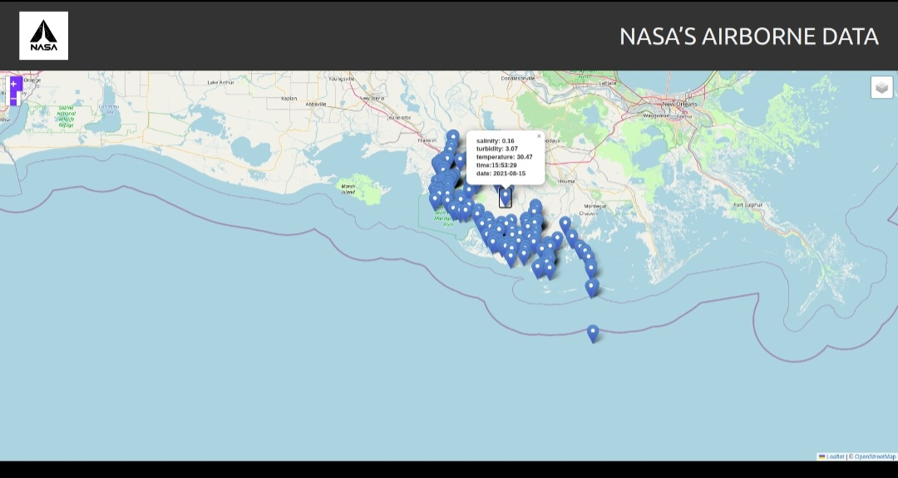
Information map

Slide 4
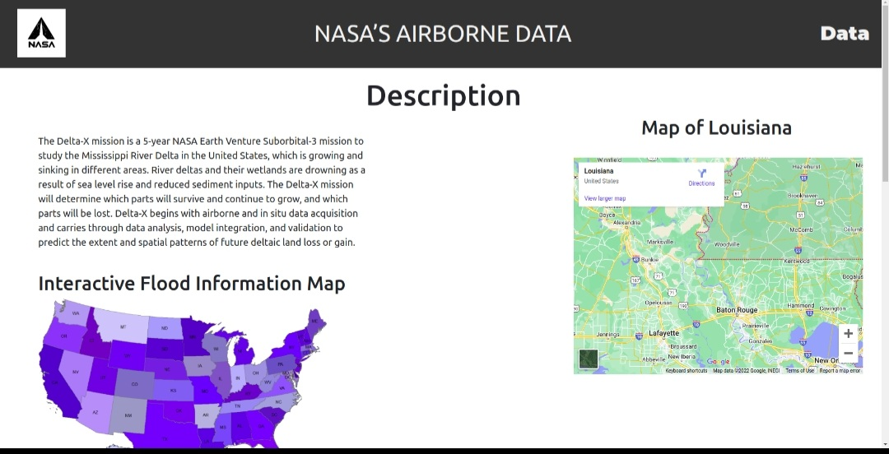
Introduction

Slide 5
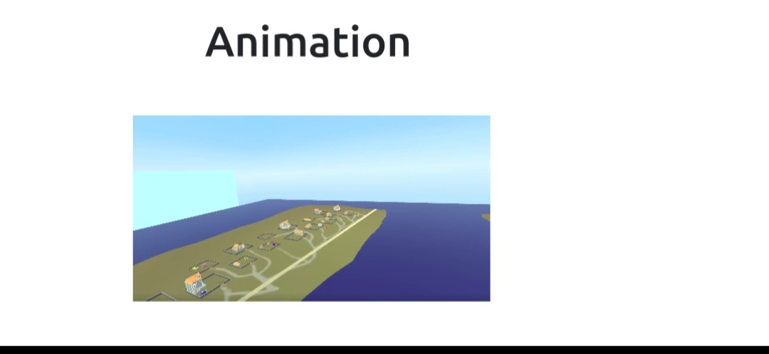
Simulation

Slide 6
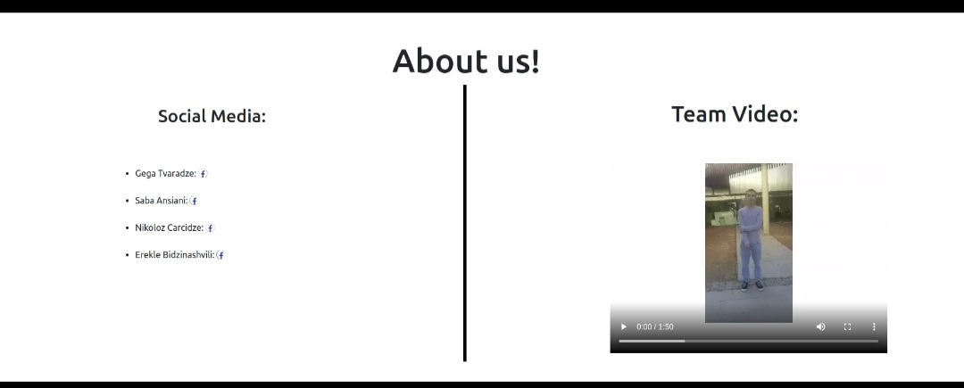
About us mini information and work process

